Slide 1
Project Title: Interactive Data Visualization with Streamlit: A Pandas and Matplotlib/Plotly Approach

Slide 2
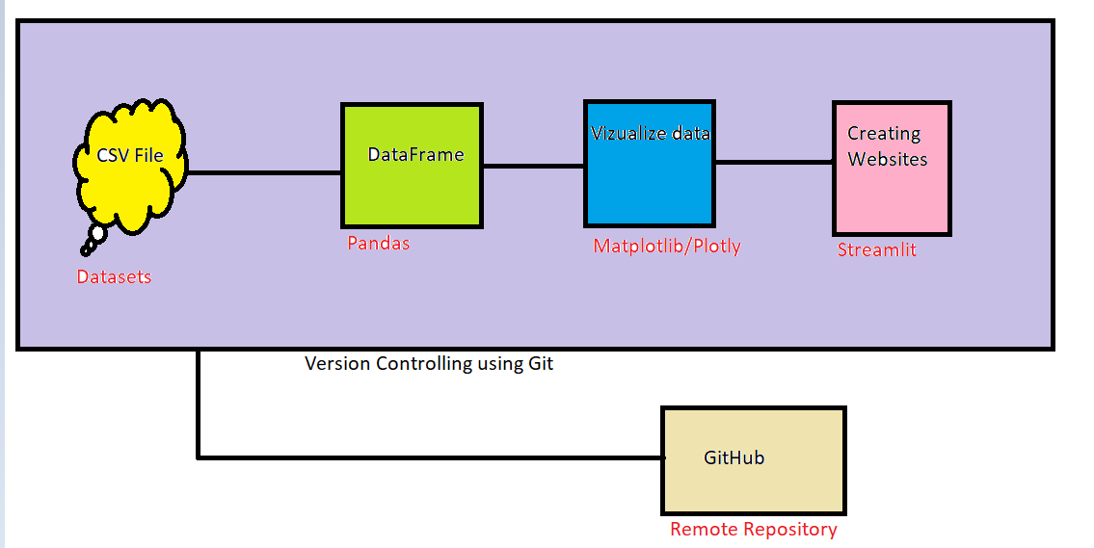
Architecture of Project:

Slide 3
Project Desc:
It outlines information related to a work items management and analysis project. The datasets used in this data analysis project includes the following columns:
Name: The name of the task holders, which is RS,PD,JP in this case.
Story_name: The name of the story associated with the data.
Dataset: The dataset in which the story is associated. It could be CE, FS, C-Equip, MA, SCA, D, DABE, SABE, ADLAE, PC, ADLE, DDBE, AI, OC, COSCBE, COM, OCT, DSP ORG, or Ind.
Sprint_id: The ID of the sprint in which the story was completed.
Year: The year in which the sprint was completed, which is 2022 in this case.
Story_points: The number of story points assigned to the story. Story points are a measure of the complexity and effort required to complete a story.
The dataset includes information on various stories completed in different sprints, along with their associated story points. The stories include tasks such as creating runbooks, tech specs, monitoring, alerting, alignment, functional, and operational tasks. The dataset also includes information on the various datasets in which the stories were completed.

Slide 4
Goal of the project:
Top employee of 2022 : Total story points obtained by every individuals
Grouped Bar Plot Showing Story Points per Sprint for all task holders.
Finding Individuals with Highest Story Points in a Single Sprint
Show top 2 highest story points for story title for all individuals
Show maximum story points in Tech and func spec for all individuals
Show maximum story points for alerting and Monitoring
Show all story points in all story title for all individuals
Pie chart showing the proportion of story points per individual

Slide 5


Slide 6
Concepts Used in Projects:
Pandas : Data Analysis
Matplotlib : Data Vizualization
Plotly : Data Vizualization
Streamlit : Interactive Website
Git : Management of multiple versions of the code
3rd Party Softwares/Tools used:
Git Bash
PyCharm
Jupyter Notebook

Slide 7
Concepts to be covered in Pandas:
read_csv
head()
Sample()
groupby()
Isin()
Pivot()
Max()
Sum()
ignore_index()
Sort_values()
Reset_index()
Pivot_table()
Concepts to be covered in Matplotlib:
Bar plot
Pie Plot
Concepts to be covered in Plotly:
Bar plot
Pie Plot
Heatmap

Slide 8
Concepts to be covered in Streamlit:
sidebar.title()
sidebar.selectbox()
Sidebar.button()
Title()
Pyplot()
Bar_chart()
Write()
Plotly_chart()
Concepts to be covered in Git:
1.git init
2.git status
3.git add
4..gitignore
5.git log/--oneline/--stat/--p
6. git show commit-num
7. git tag -a tag_name(v1.0.0)
8. git tag -d tag_name
9. git tag -a tag_name(v1.0.0) commit-num
10. git branch
git branch error-fix commit-num

Slide 9
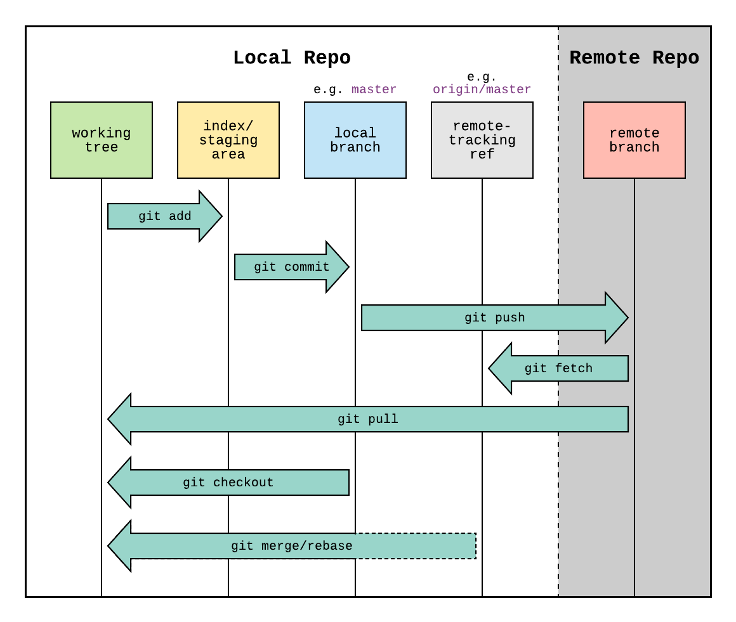
11. git checkout
12. git log --oneline --all
git log --oneline --all --graph
13. git branch -d name (error if not merged)
git branch -D name
14. git merge branch_name
15. git remote or -v
16. git push
17. Git reset

